Slide 1
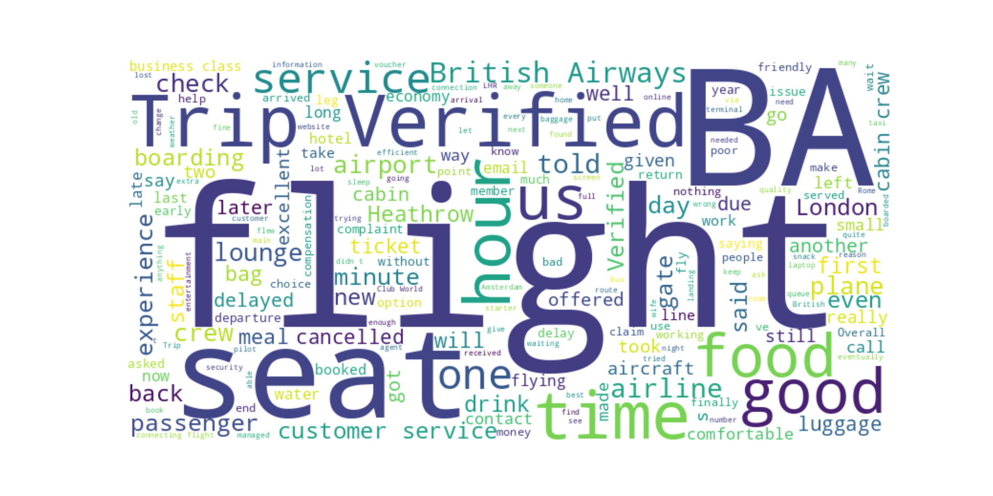
Customer Sentiment Analysis – British Airways

Slide 2
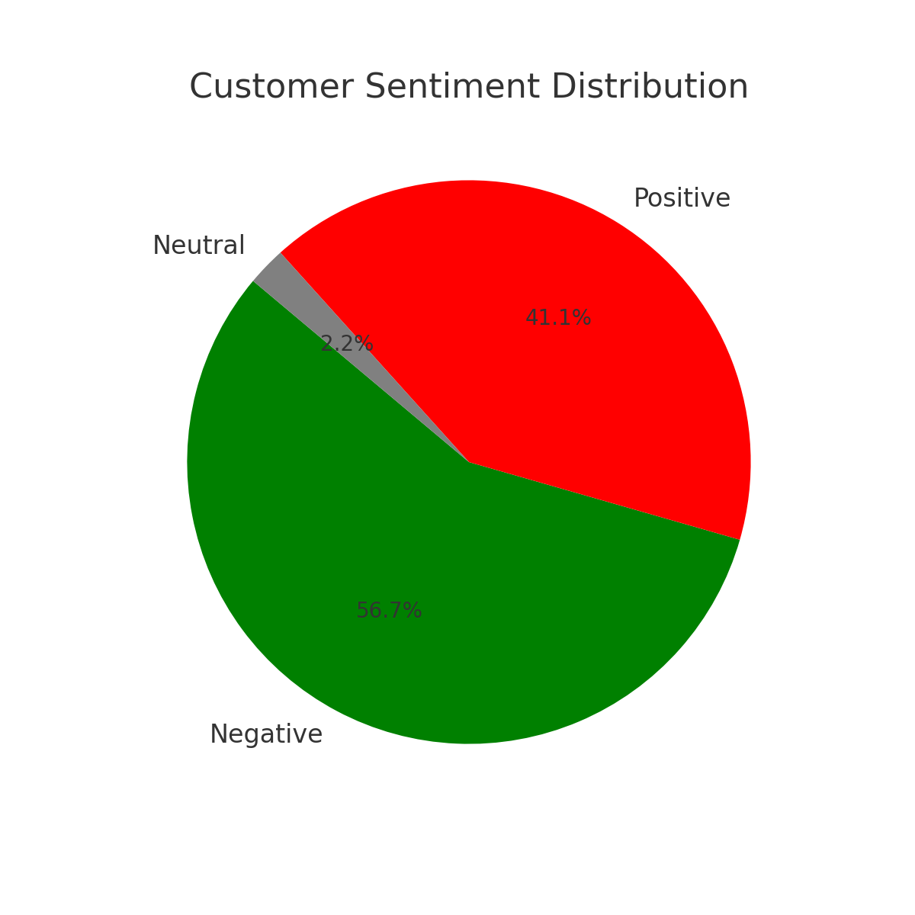
Key Metrics
• Total Reviews Analyzed: 90
• Positive: 37
• Negative: 51
• Neutral: 2

